Slide 1
Power BI dataflows
The Missing Piece in Your Power BI Architecture!

Slide 2

Chuck Finance

Slide 3

Rose Human Resources

Slide 4

Rose Human Resources

Slide 5
Power BI dataflows
The Missing Piece in Your Power BI Architecture!

Slide 6
Agenda
What are dataflows?
Why and how to use dataflows
Common Data Model integration
Azure Data Lake Storage gen2 integration
AI features

Slide 7




Dave Ruijter
Data & AI Consultant
Macaw Netherlands
dave.ruijter@macaw.nl
@DaveRuijter daveruijter
moderndata.ai

Slide 8
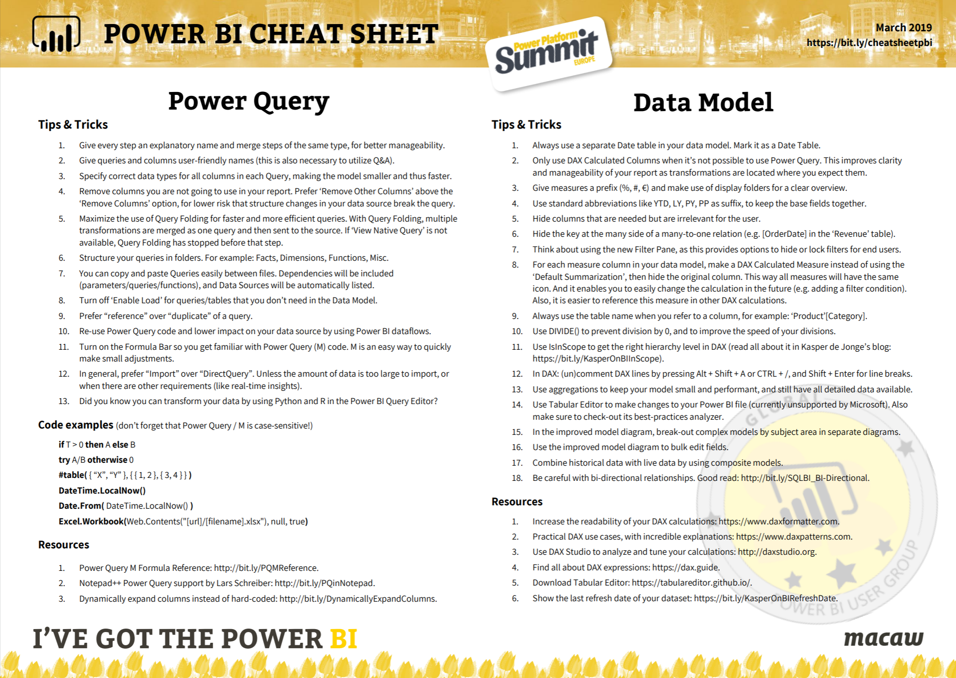

Download for free!
https://bit.ly/cheatsheetpbi

Slide 9

Which ‘data flow’ are you talking about..?

Slide 10
What are Power BI dataflows?
A self-service low-code/no-code ETL tool in the Power BI Service
A collection of entities (e.g. tables), fuelled by Power Queries
They provide reuse of Power Queries and tables between Power BI datasets
You create and manage them in an App Workspace

Slide 11







Self-Service BI
OLTP systems
Data Warehouse
Reports and dashboards
Data Lake
Data Preparation / ETL
OLAP / Analytics Models

Slide 12
Demo!
Intro:
Power BI dataflows

Slide 13
Why and when to use dataflows..

Slide 14
Why and when use dataflows?
When the DWH and/or Data Lake route is not an option (for now)
Reuse transformation logic
Share Power Queries for standard entities like Date dimension
Share and reuse advanced Power Queries
Reduce load on source systems
Less performance impact
Slow sources like SharePoint (throttling!)
Isolate data refreshes from different sources
Bridging the ‘gap’ to Azure Data Lake for the business user

Slide 15
Without dataflows, users will..
Be blocked on IT involvement
Use Excel and manual processes
Require 3rd party data preparation tools like Alteryx, Datameer, Trifacta, etc.

Slide 16
Connecting to / consuming dataflows
From a dataflow by creating a ‘Linked Entity’
From a dataflow by creating a ‘Computed Entity’
From Power BI Desktop, just as any data source (you can save the dataset in any workspace!)

Slide 17
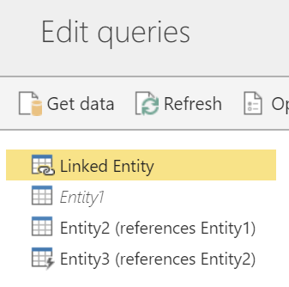
Linked Entities 🔗
Points to an entity in other dataflow
Does not copy or duplicate data
If the entity is in the same App Workspace data refresh will be automatically ‘chained’
Requires Premium 💎
Source entity does not require Premium
Works only on New App Workspaces

Slide 18
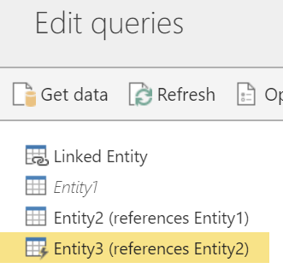
Computed Entities ⚡
‘in-storage computations’, after data is already loaded and stored
Like referenced queries in datasets
You can still reference another entity without creating a linked entity, by disabling load of the other entity
Requires Premium 💎

Slide 19
Demo!
Linked Entities
Computed Entities

Slide 20
Licensing notes
Pro
Premium💎 (EM3-P3, A1-A6)
Creating dataflows
Consuming dataflows
8 refreshes
10 GB/user
Computed Entities
Linked Entities
External dataflow (CDM Folder)
Incremental refresh
48 refreshes
100 TB/node

Slide 21
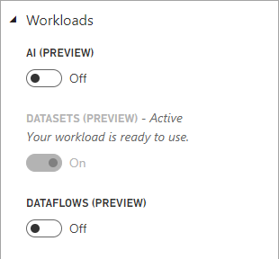
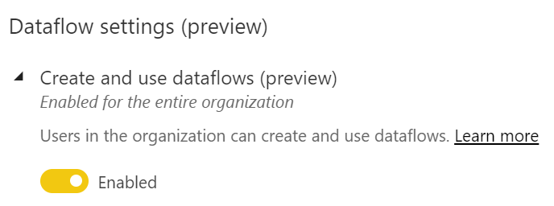
General notes (1)
Still in preview
Currently only creator can edit a dataflow
Enable workload when in Premium:
Tenant setting:

Slide 22
General notes (2)
Personal Gateway is not supported
Using Enterprise Gateway requires to be admin
Each dataflow is limited to 1 gateway

Slide 23
Common Data Model integration

Slide 24
Common Data Model
Provides a simple and consistent way of describing and saving data
Streamline data exchange between solutions and organizations
By default Power BI dataflows store data in the CDM data format
You can map your entities to known CDM entities (known schemas)
Benefit by quickly reusing out-of-the-box analytical solutions

Slide 25
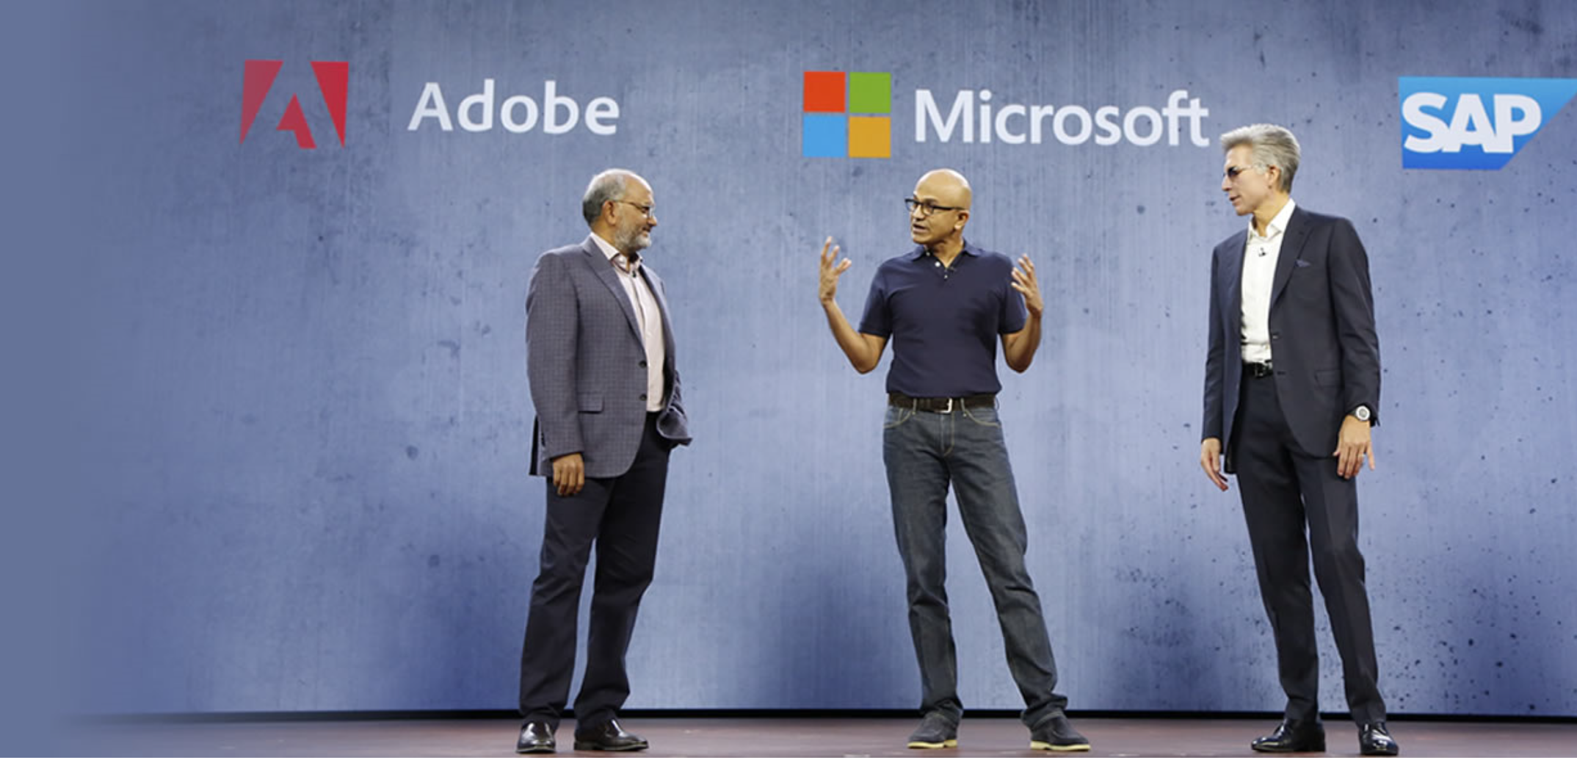
Announcing the
Open Data Initiative
Deliver unparalleled business insight from your behavioral, transactional, financial, and operational data with the Open Data Initiative—a jointly-developed vision by Adobe, Microsoft, and SAP.
A collection of standard data formats that make data exchange between applications and platforms a simple reality.

Slide 26
Azure Data Lake Storage Gen2 integration

Slide 27
Bring your own dataflow storage
Still managed by Power BI
Managed by you
Same as before, but now in your Storage Account in Your Azure subscription
Power BI owns CDM folder, read-access for other services
Create a CDM folder in your Storage Account, map it to a dataflow
You own the CDM folder, Power BI has read-access, no Power Query edits possible

Slide 28
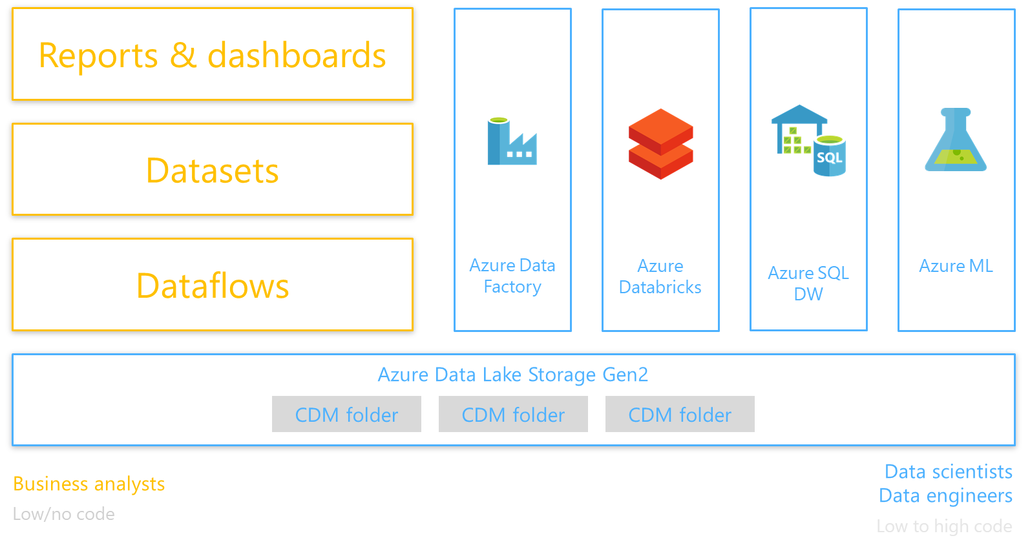

Slide 29
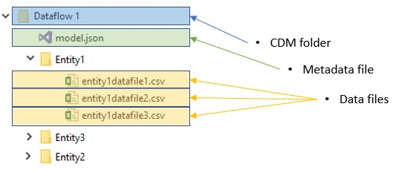
Dataflows in Azure Data Lake

Slide 30
Demo!
Power BI dataflows &
Azure Data Lake Storage Gen2

Slide 31
General notes (ADLSgen2 integration)
Only for Workspaces v2
Read permissions on the CDM folder, subfolders and files
Execute permissions on the CDM folder and subfolders
Once a dataflow storage location is configured, it cannot be changed
When mapping the dataflow to the CDM folder, encode the uri, e.g. replace spaces with %20 etc.

Slide 32
General notes (ADLSgen2 integration)
Dataflows based on CDM folders cannot be edited in Power BI
Permissions to read a dataflow created from a CDM folder is managed by the owner of the CDM folder, and not by Power BI
Only users who are authorized to both the workspace in which the dataflow was created, and the CDM folder, can access its data from the Power BI dataflows connector
Linked entities are not available for dataflows created from CDM folders

Slide 33
General notes (ADLSgen2 integration)
When PBI manages storage: Linked Entities and Computed Entities only work when entities reside in the same storage account
When you manage storage (and use CDM folders): Linked entities are not available

Slide 34
General notes (ADLSgen2 integration)
When doing computations on data joined by on-premises and cloud data, create a new entity to perform such computations.
This provides a better experience than using an existing entity for computations, such as an entity that is also querying data from both sources and doing in-lake transformations.

Slide 35
AI features

Slide 36
AI features in dataflows
Invoke Cognitive Services to enrich your data
Easily invoke your Azure Machine Learning models
Create new Machine Learning models with AutoML

Slide 37
Demo!
Power BI dataflows &
AI features

Slide 38
Roadmap for dataflows
Over time, Azure Machine Learning, Azure Databricks, Azure Data Factory, etc. will have built-in support to read and write Common Data Model-compliant folders
Shared ownership (edit dataflows of other authors)
Enhancements to the dataflow calculation engine to enable high-performing large-scale data transformations (TBs)

Slide 39
Dataflows Diagram view
Power BI Dataflows and ADLS Gen2 Integration Public Preview
November
January
March+
December
February
Dataflows Public Preview
Power Query Online integration + Connectors
Computed entities
Linked entities
Partition-based Incremental Refresh
Native Queries support
New connectors support (MySQL, Teradata, Azure Data Explorer, AAD, Redshift, SmartSheet, Sybase)
Dataflows GA
Email notifications on failed refresh
Dataflows “Take Ownership”
Cancel refresh of a Dataflow
Perf Enhancement: SQL Compute engine (preview)
Preserve Entity Relationships from data source
ADLS dataflow access governed by workspace permissions (SAS)

Slide 40
Power BI dataflows FAQ
A new capability for self-service data preparation in Power BI
Delivered in a familiar Power Query experience
Built on the foundation of Azure Data Lake Storage gen2
Utilize the CDM folder format for data storage
A tool for business users to drive data reuse without requiring IT involvement
Enable Excel-like data lineage and orchestration
NOT a replacement for datasets
NOT a replacement for a data warehouse
NOT a replacement for Azure Data Factory or SSIS
NOT a Premium-only feature
NOT an additional cost or fee
NOT spelled with a space or any capital letters

Slide 41
Session resources
Dataflows on public Microsoft sites:
Dataflows documentation: https://docs.microsoft.com/en-us/power-bi/service-dataflows-overview
Dataflows roadmap / release notes: https://docs.microsoft.com/en-us/business-applications-release-notes/April19/business-intelligence/power-bi-service/power-bi-dataflows/self-service-data-prep-with-dataflows
Dataflows on Power BI Ideas: https://ideas.powerbi.com/forums/265200-power-bi-ideas?category_id=341638
Common Data Model on public Microsoft sites: :
Common Data Model documentation: https://docs.microsoft.com/en-us/common-data-model/
Common Data Model on GitHub: https://github.com/Microsoft/CDM
End to end CDM partner sample: https://aka.ms/cdmadsblog
AI in Power BI
Machine Learning in Power BI: https://docs.microsoft.com/en-us/power-bi/service-machine-learning-integration
Cognitive Services in Power BI: https://docs.microsoft.com/en-us/power-bi/service-cognitive-services
Matthew Roche’s blog:
Dataflows landing page: https://ssbipolar.com/2018/10/23/dataflows-in-power-bi/
Dataflows FAQ: https://ssbipolar.com/2018/11/27/power-bi-dataflows-faq/

